Slide 1

Title: Airline Price & Performance Analysis
Submitted By:
Shabnam Ikram
Ankit Yadav

Slide 2
Project Overview
This project explores how various flight attributes — such as airline, route, stops, class, and booking window — influence the price of domestic air travel in India.
We use over 3 lakh real flight entries to analyze:
- How early booking affects price
- How airlines differ in pricing strategy
- Influence of departure/arrival time, stops, and class
- Patterns in flight duration and city routes

Slide 3
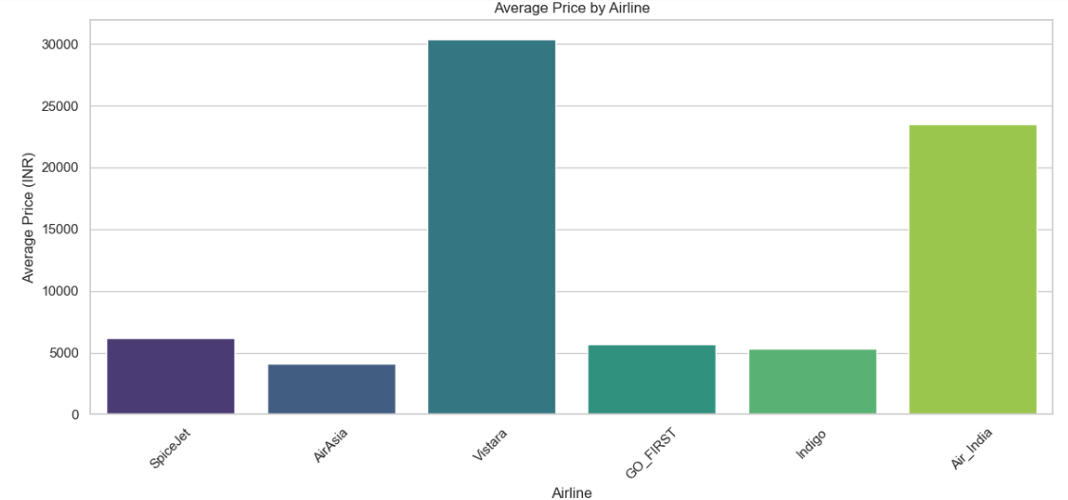
Average Price by Airline
Chart Type: Bar Plot
Why We Plotted This: To compare average ticket prices across different airlines. Insight:
What It Shows: Airlines like Jet Airways and Multiple Carriers have significantly higher average prices, while SpiceJet and Air Asia offer cheaper fares.

Slide 4
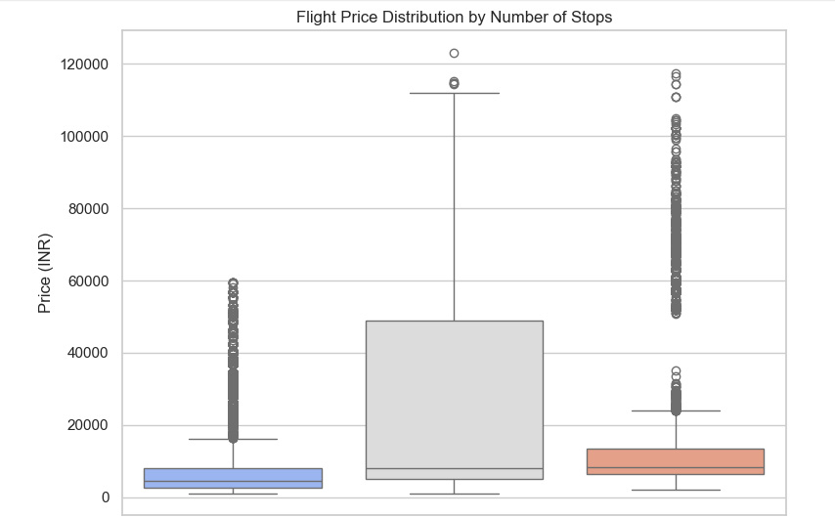
Stops vs Price
Chart Type: Box Plot
Why We Plotted This: To examine how the number of stops impacts ticket price.
What It Shows:
Non-stop flights have the lowest median price
Real-world impact:
1 stop and 2 stop flights show a wide price range and higher average prices..
ZERO ONE STOP TWO OR MORE

Slide 5
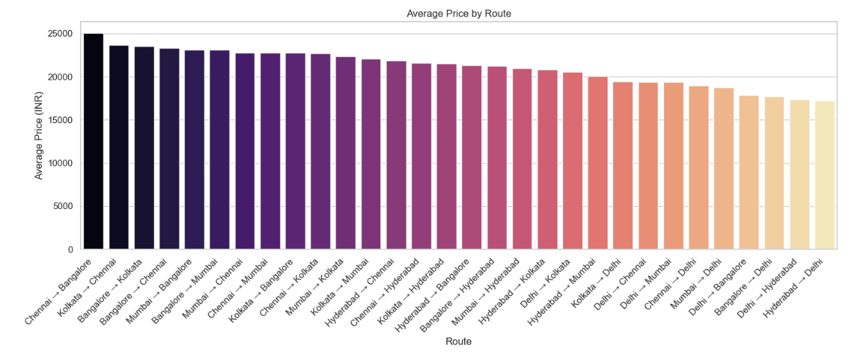
Price by Source-Destination Pairs
Plot Explanation: Bar Plot
Why We Plotted This: To visualize price variation across different source-destination routes.
What It Shows:
Routes like Delhi to Cochin and Mumbai to Hyderabad show higher median prices.
Routes like Chennai to Kolkata are comparatively cheaper.

Slide 6
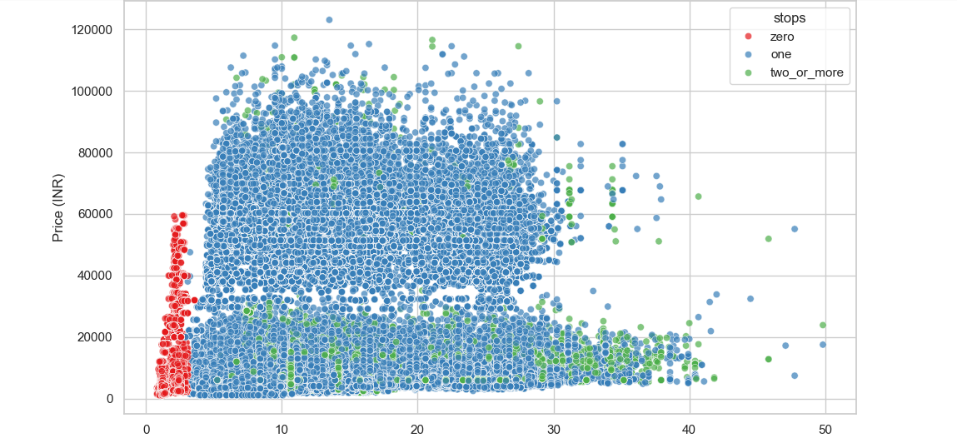
Duration vs Price
Chart Type: Scatter Plot
Why We Plotted This: To see if longer flight duration correlates with higher prices.
What It Shows: There is a positive correlation — generally, longer durations lead to higher prices, though some exceptions exist.

Slide 7
0-stop vs 1-stop
This analysis compares ticket prices for flights with different numbers of stops.
Why this is done:
To understand how number of stops affects airfare — does a non-stop flight cost more or less than one with layovers?
What we figure out:
Flights with more stops generally have higher variability in prices.
Non-stop flights tend to be more consistent and often cheaper.
It suggests that passengers might pay a premium for convenience, but also that more stops don't always mean cheaper tickets.

Slide 8
Airline-wise Fare Difference
The analysis compares the ticket prices offered by different airlines.
Why this is done: To identify which airlines are costlier or cheaper, and whether fare differences are due to service levels, routes, or brand premium.
What we figure out:
Airlines like Jet Airways and Air India typically have higher average fares.
Budget airlines like SpiceJet and AirAsia offer lower fares.
This helps understand how brand and service tiers influence pricing strategies.

Slide 9
Duration & Price
This analysis looks at how flight duration relates to ticket price.
Why this is done: To check whether longer flights are more expensive — and if duration is a key driver of cost.
What we figure out:
There is a positive relationship — longer flights often cost more.
However, some shorter flights are also expensive, likely due to high demand or limited competition.
. Duration is not the only factor, but it’s a significant contributor to price.

Slide 10
Total Stops vs Price Category
The analysis classifies ticket prices into categories (like low, medium, high) and compares them based on the number of stops.
Why this is done:
To see whether flights with more stops tend to fall into higher or lower price categories.
What we figure out:
Low price flights are mostly non-stop or 1-stop.
Flights with 2 or more stops usually fall into medium to high price ranges.
This shows that complexity of the route (more stops) contributes to higher pricing tiers.

Slide 11
Summary
More stops → more time and higher fare variability
Airlines differ widely in pricing based on brand and service type
Flight duration is a strong indicator of cost
Non-stop flights dominate the low-price segment, whereas multi-stop routes shift toward premium pricing

Slide 12
THANK YOU

